Slide 1

AL-FARABI KAZAKH NATIONAL UNIVERSITY
Department of political science and political technologies
Political systems and regimes
Abzhapparova A.A.
Senior lecturer

Slide 2
Political systems and regimes
Lecture 1
Introduction. General theory of systems. Categories of system analysis

Slide 3
Lecture plan:
The causes of the general theory of systems.
The subject of systems theory. Definition of the system.
The basic concepts and patterns of the theory of systems.
Examples of system classification.

Slide 4
A person constantly encounters the concept of "system" both in scientific research and in solving complex practical problems, as well as at the household level, in everyday life. Systems surround us everywhere.
The need to use the term "system" arises in cases where it is necessary to emphasize that something is large, complex, not completely immediately understandable, while being whole, unified. Unlike the concepts of "set", "totality", the concept of a system emphasizes orderliness, integrity, the presence of structure, patterns of construction, functioning and development.

Slide 5
Examples of systems:
The solar system.
A system of linear equations.
The human nervous system.
The city's water supply system.
The organization's management system.
Automated accounting system.

Slide 6
The causes of the general theory of systems
Primitive man, interacting with his natural and social environment, was already capable of systematic thinking when he chose a place for housing (parking), developed a "scenario" for future hunting, planned relocation or chose a tribal leader.

Slide 7
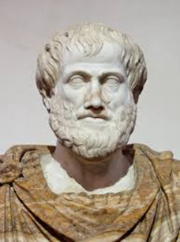
The first scientific and documented ideas about systems arose in ancient philosophy, which put forward an ontological interpretation of the system as the orderliness and integrity of being. Even in ancient Greek science (Euclid, Plato, Aristotle, Stoics), the idea of systematic knowledge (axiomatic construction of logic, geometry) was developed.
The system (in ancient Greek σύστημα) is literally: a whole made up of parts; a compound.
One of its brief definitions is: a system is a set of elements that are in relationships and connections with each other, which forms a certain integrity, unity.
Aristotle: "The whole is greater than the sum of its parts."

Slide 8
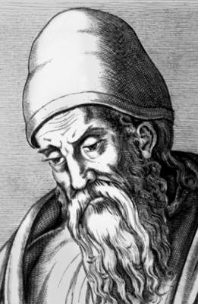
The system of Euclid's axioms is set out in his main work, "Principles" (in Latinized form - "Elements") and contains a systematic exposition of planimetry, stereometry and a number of issues of number theory. In it, he summed up the previous development of ancient Greek mathematics and created the foundation for the further development of mathematics.
For example, geometry in the "Beginnings" is constructed as an inference system of knowledge in which all propositions are consistently deduced one after another along a chain based on a small set of initial statements accepted without proof (postulates or axioms). According to Aristotle, such initial statements "must exist, since the chain of inference must begin somewhere in order not to be endless."

Slide 9
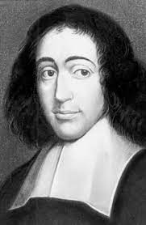
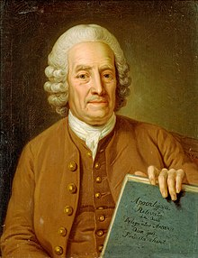
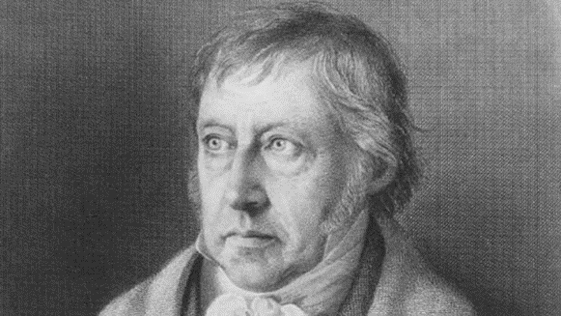
The ideas and ideas about the system of being that appeared in ancient authors continued to develop both in the concepts of medieval philosophers and further in the works of B. Spinoza and G. Leibniz, in the constructions of scientific systematics of the 17th and 18th centuries, which sought a natural (and not theological) interpretation of the system of the world (example: classification of plants by K. Linnaeus). According to I. Kant, "scientific knowledge is a system in which the whole dominates over the parts." F. Schelling and G. Hegel interpreted the system of cognition as the most important requirement of dialectical thinking.

Slide 10
In the bourgeois philosophy of the 2nd half of the XIX and early XX centuries, with a general idealistic solution to the main question of philosophy, there are statements, and in some cases solutions to some problems of systemic research – the specifics of theoretical knowledge as a system (neo-Kantianism), the features of the whole (holism, Gestalt psychology), methods of constructing logical and formalized systems (neopositivism). In contrast, in Marxist philosophy, the principles of materialistic dialectics are the basis for the study of systems – the universal connection of phenomena, development, contradiction, etc. (K. Marx and F. Engels). An important contribution to the formation of systemic ideas was made at the beginning of the XX century by A.A. Bogdanov, who proposed a universal organizational science – tectology.

Slide 11
Since the 2nd half of the XIX century, the intensive penetration of the concept of a system into various fields of concrete scientific knowledge began. Of no small importance for this was the creation of the evolutionary theory of Ch. Darwin, the appearance of the periodic table of chemical elements by D.I. Mendeleev, the emergence and development of the theory of relativity, quantum physics, etc. The task of strictly defining the concept of a system and developing methods for analyzing systems, which has not been completely solved so far, becomes urgent. In the 40-50s of the twentieth century. Intensive research in this area has continued to meet the needs of energy, engineering disciplines, electronics and cybernetics.

Slide 12
Prerequisites for the emergence of the general theory of systems: the achievements of formal logic in the XIX century. some scientific disciplines have reached a level of development that allowed them to discover common approaches and similar theories (early XX century.) the emergence of information theory (mid XX century.) the emergence of formal linguistics and programming languages (XX century.)

Slide 13
The subject of systems theory. System definition
The subject of systems theory is systems of arbitrary nature.
There is no generally accepted definition of the system and (apparently) cannot exist. The available definitions differ in the degree of generality and the limits of applicability.
One of the definitions: A system is a set of components of the unity of elements, their connections and interactions between themselves and between them and the external environment, forming the integrity inherent in this system, qualitative certainty and purposefulness.
The concept of a system comes from the ancient Greek root, denoting a combination, an organism, an organization, a union (literally – "made up of parts"); it implies the order inherent in the named phenomenon, object

Slide 14
The general theory of systems is an interdisciplinary science that studies the fundamental concepts and aspects of systems, distracting from their specific nature and based on the formal relationships between their constituent factors, as well as on the nature of their changes under the influence of external conditions.
Currently, it is developing in the following directions:
- systemology;
- system engineering;
- system analysis.

Slide 15
The subject of systems theory is systems, as well as methods of creating, studying and developing systems.
Problems of systems theory:
− Development of general system concepts. The construction of generalized conceptual models of systems of various classes.
− Development of general principles of organization and logical and mathematical apparatus for system research.
− Creation of various partial theories of systems.

Slide 16
A systematic approach is understood as a set of methods and tools that allow us to explore the properties, structure and functions of objects and processes of interest to us as a whole, presenting them as systems.
It allows you to: identify commonalities in objects of different nature, choose an appropriate decision-making method, give an adequate information description (characterization of species, assessment of the amount of information about the object of study, simulate ways of information exchange between it and the environment), take into account existing uncertainties and risks, predict and explain the result of the study.

Slide 17
The term "system analysis" is not a completely correct translation of the term "system analysis" that appeared in the 60s in the USA to denote the technique of analyzing complex systems. System analysis in the modern sense is a synthesis of ideas and principles of the general theory of systems, cybernetics with the capabilities of modern computing technology. It has as its subject the study and modeling of objects of complex nature (systems), taking into account their organization, i.e. the interrelation of individual parts.
According to L.F. Bertalanfi's definition, "system analysis is formalized common sense."

Slide 18
System analysis is an applied branch of systems theory whose principles and methods are used when: a) there is a large initial uncertainty of the problem situation; b) it is necessary to devote a lot of attention and time to setting the task (both qualitative and formal); c) the basic concepts and patterns of the theory of systems are used; d) both individual and collective decision-making is possible; e) the process of goal formation research and the specifics of setting goals turns out to be important.

Slide 19
System analysis in the modern sense is a synthesis of ideas and principles of the general theory of systems, cybernetics with the capabilities of modern computing technology. It has as its subject the study and modeling of objects of complex nature (systems), taking into account their organization, i.e. the interrelation of individual parts.

Slide 20
System analysis provides the following system-wide methods and procedures for use in various sciences and systems:
abstracting and concretization;
generalization;
analysis and synthesis, induction and deduction;
composition and decomposition;
linearization and separation of nonlinear components;
structuring and restructuring;
layout design;
algorithmization;
modeling and experiment;
recognition and identification;
clustering and classification;
expert assessment and testing;
classification;
verification, etc.

Slide 21
The basic concepts and patterns of the theory of systems
1) Elements are all kinds of conditionally indivisible and independently functioning parts of the system.
Another definition: The element is the limit of the division of the system in terms of the set goal, the task to be solved.
Example: From the point of view of a carpenter making a stool, a stool can be divided into legs, seat, sides, fittings. From the point of view of a physicist – on molecules, atoms. In this case, the seat and legs will be considered as subsystems.

Slide 22
A subsystem is a relatively independent part of the system, having its own sub–goal, purpose.
Examples: organizational units, types of computer system support.
Component is a set of relatively homogeneous elements united by a common function and resource

Slide 23
One of the main methods of studying systems, decomposition, is closely related to the concept of a subsystem. Decomposition is the division of the whole into parts (subsystems, elements). It is also a scientific method that uses the structure of the problem and allows you to replace the solution of one large problem with the solution of a series of smaller tasks, albeit interrelated, but simpler.
Decomposition, as a process of dismemberment, allows us to consider any system under study as complex, consisting of separate interconnected subsystems, which, in turn, can also be divided into parts. Not only material objects can act as systems, but also processes, phenomena and concepts.

Slide 24
A connection is a set of dependencies of the properties of one element on the properties of other elements of the system.
Sometimes a connection is defined as a temporary loss by elements of some of their qualities that they would have possessed outside the system.
Examples of types of connections: mechanical, physical, chemical, biological (interspecific, intraspecific, genetic), social, managerial.

Slide 25
Among the interconnections in the systems, there is also an important division into direct and inverse ones. A direct connection is a connection in which one element (A) acts on another (B) without a response: A →B. Example: The sun acts on all earthly processes.
In the case of feedback, element B responds to the action of element A (demonstrates a response). Example: employee reports on the work done.
There is positive and negative feedback. They play an important role in natural processes. A positive feedback leads to an intensification of the process in one direction (supports the existing trend). In the case of a negative feedback, in response to the action of element A, a counter force opposite in direction arises from element B. Therefore, positive feedback enhances the effect of the input signal, negative feedback weakens it.

Slide 26
Structure is a set of connections and elements that play the most important role in ensuring energy, mass and information exchange not only within the system itself, but also between it and its environment. This is the most stable set of elements and connections of the system in time (space).
Examples of structures: linear, centralized, hierarchical, network, matrix, etc.

Slide 27
The goal is the desired state of the system (or environment) or the desired result of the behavior of the system, achievable within a certain time interval.
The goal becomes the task facing the system if the deadline for its achievement is specified and the characteristics of the desired result are determined. The goal is achieved as a result of solving a problem or a number of tasks, if it can be divided into a set of simpler (private) subtasks. This is the "ideal" result of activity in the future, for which the system is being created and researched.

Slide 28
Requirements for goals:
achievability;
intelligibility to performers (if any);
consistency;
measurability (qualitatively and/or quantitatively);
availability of resources.
Goals depend on: the time of achievement, the knowledge and experience of managers and performers, external circumstances and internal conditions.

Slide 29
The goal of the system can be formed in two ways:
Be set from the outside (external requirements, needs, motives, programs). In this case, the goal is set by a higher-ranking system.
Be installed inside the system according to its needs, motives, and the program of the system itself.

Slide 30
Methods of constructing a target model in the form of a tree–like graph have become very popular – a tree of goals, the top of which becomes the general goal, and the branches are sub-goals, the achievement of which ensures the achievement of the general goal, and which themselves depend on solving more "small" tasks.
The goal tree describes an ordered hierarchy in the following sequence: common goal = sub-goals of the next level = tasks = tasks = ..., if necessary, dividing the achievement of the goal into the required number of levels.

Slide 31
External environment
The concept arises where and when we materially or speculatively draw a closed boundary between an unlimited or some limited set of elements. Those elements with their corresponding mutual conditionality that get inside form a system.
Those elements that remain outside the boundary form a set, called in system theory a "system environment" or simply an "environment" or "external environment".
It follows from these arguments that it is unthinkable to consider a system without its external environment. The system forms and manifests its properties in the process of interaction with the environment, while being the leading component of the "system" of this influence.

